Slide 1
Linear Regression
UWIZEYE Delphine

Slide 2
content
Regression analysis
Underfitting and overfitting
Linear regression

Slide 3
Regression analysis
Supervised learning type of machine learning.
Searches for relationships among variables.
Used to forecast a response using a new set of predictors.
Regression may be linear(simple linear and multiple linear) or non-linear

Slide 4
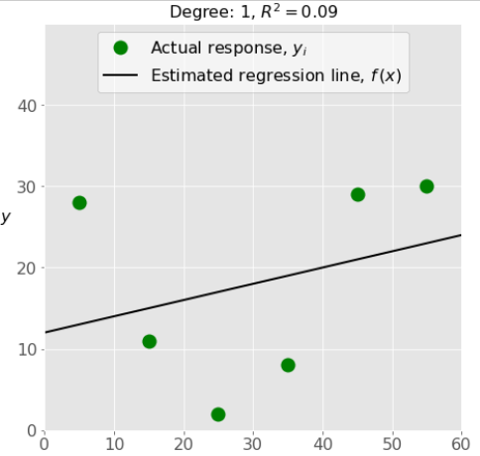
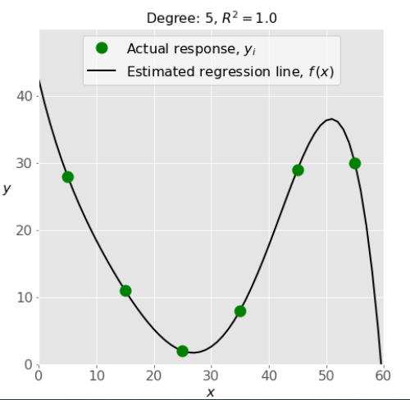
Underfitting and overfitting
Underfitting
Means that the model does not fit the training data
Overfitting
Means that the model fits the training data too well

Slide 5
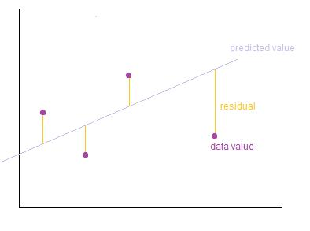
Linear regression
Regression equation: 𝑦 = 𝛽₀ + 𝛽₁𝑥₁ + ⋯ + 𝛽ᵣ𝑥ᵣ + 𝜀. Where
Y: dependent variable, output or actual response.
𝐱 = (𝑥₁, …, 𝑥ᵣ): independent variables, inputs or predictors.
𝛽₀, 𝛽₁, …, 𝛽ᵣ are the regression coefficients,
𝜀 is the random error.
r is the number of predictors.
Estimated regression function 𝑓(𝐱) = 𝑏₀ + 𝑏₁𝑥₁ + ⋯ + 𝑏ᵣ𝑥ᵣ.(regression model) Where 𝑏₀, 𝑏₁, …, 𝑏ᵣ are predicted weights.
𝑦ᵢ - 𝑓(𝐱ᵢ) for all observations 𝑖 = 1, …, 𝑛, are called the residuals. Regression is about determining the best predicted weights, that is the weights corresponding to the smallest residuals.
To get the best weights, you usually minimize the sum of squared residuals (SSR) for all observations 𝑖 = 1, …, 𝑛: SSR = Σᵢ(𝑦ᵢ - 𝑓(𝐱ᵢ))² also called Mean Squared Error(MSE).

Slide 6
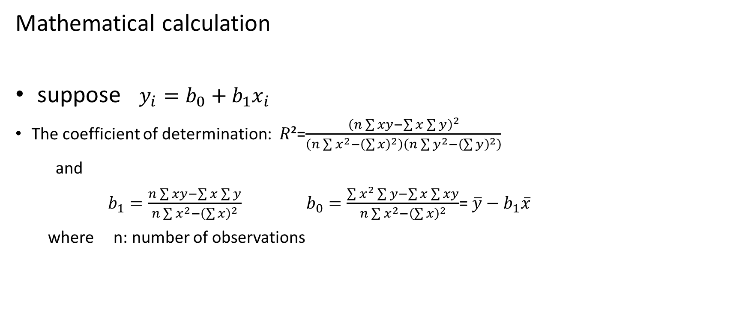
Linear regression
Mathematical calculation
suppose $y_{i}=b_{0}+b_{1}x_{i}$
The coefficient of determination: 𝑅²=$\frac{{\left(n\sum{xy−\sum{x\sum{y}}}\right)}^{2}}{\left(n\sum{x^{2}}−{\left(\sum{x}\right)}^{2}\right)\left(n\sum{y^{2}}−{\left(\sum{y}\right)}^{2}\right)}$
and
$b_{1}=\frac{n\sum{xy−\sum{x\sum{y}}}}{n\sum{x^{2}}−{\left(\sum{x}\right)}^{2}}$ $b_{0}=\frac{\sum{x^{2}\sum{y−\sum{x\sum{xy}}}}}{n\sum{x^{2}−{\left(\sum{x}\right)}^{2}}}$= $\overline{y}−b_{1}\overline{x}$
where n: number of observations

Slide 7
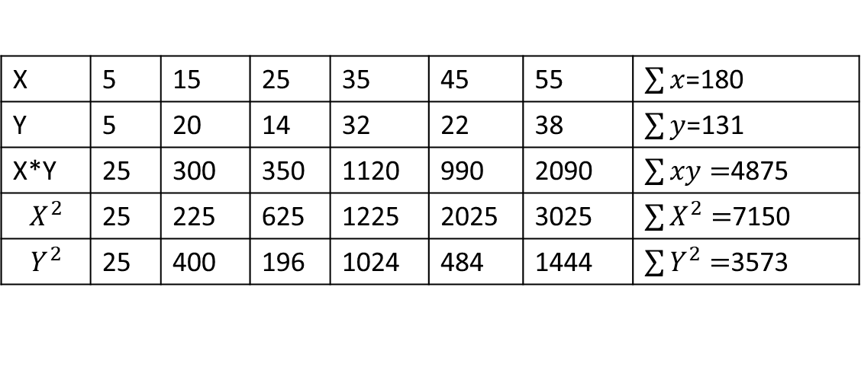

Linear regression Mathematical calculation
Example:
N=6 𝑅²=$\frac{{\left(n\sum{xy−\sum{x\sum{y}}}\right)}^{2}}{\left(n\sum{x^{2}}−{\left(\sum{x}\right)}^{2}\right)\left(n\sum{y^{2}}−{\left(\sum{y}\right)}^{2}\right)}$ =$\frac{{5670}^{2}}{10500∗4277}$ =0.71587…
$b_{1}=\frac{n\sum{xy−\sum{x\sum{y}}}}{n\sum{x^{2}}−{\left(\sum{x}\right)}^{2}}$=$\frac{6∗4875−(180∗131)}{6∗7150−{180}^{2}}$=0.54
$b_{0}=\frac{\sum{x^{2}\sum{y−\sum{x\sum{xy}}}}}{n\sum{x^{2}−{\left(\sum{x}\right)}^{2}}}$=$\frac{7150∗131−(180∗4875)}{6∗7150−{180}^{2}}$=$\frac{169}{30}$=5.6333…
X | 5 | 15 | 25 | 35 | 45 | 55 | $\sum{x}$=180
Y | 5 | 20 | 14 | 32 | 22 | 38 | $\sum{y}$=131
X*Y | 25 | 300 | 350 | 1120 | 990 | 2090 | $\sum{xy=}$4875
$$X^{2}$$ | 25 | 225 | 625 | 1225 | 2025 | 3025 | $\sum{X^{2}=}$7150
$$Y^{2}$$ | 25 | 400 | 196 | 1024 | 484 | 1444 | $\sum{Y^{2}=}$3573

Slide 8
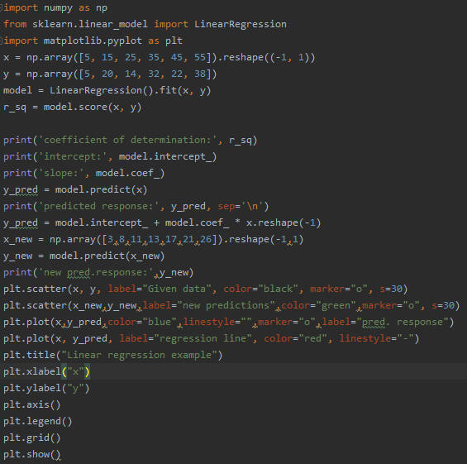
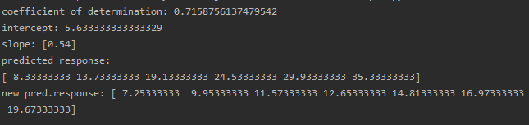
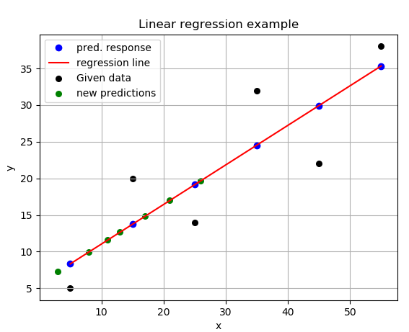
Linear regression in python
Simple linear regression

Slide 9
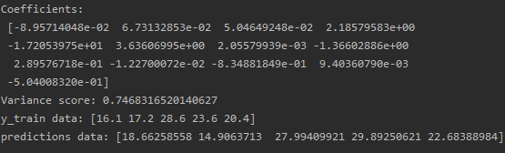
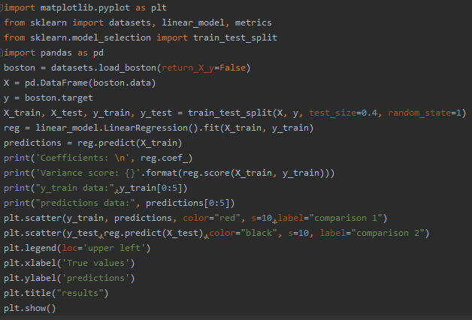
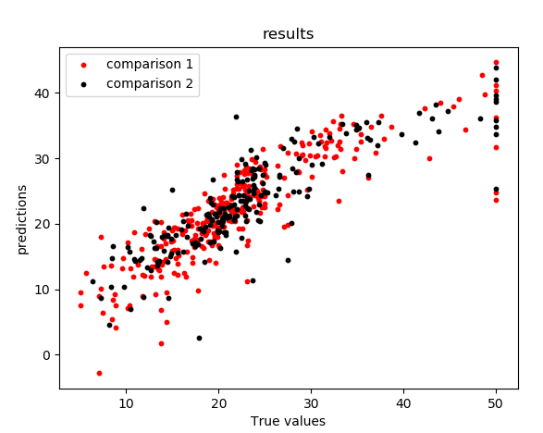
Linear regression in python
Multiple linear regression

